Slide 1
Investigation of Cytotoxic, Genotoxic and Apoptotic Effects of Thymoquinone-oxime on Glioma Cells
Burak Mert BEKTAŞ
Asst. Prof. Eray Metin GÜLER
Bezmialem Vakif University
June 2021

Slide 2
Contents
Gliomas
Thymoquinone
Introduction
Materials and Methods
Results
Conclusion
Discussion
References

Slide 3
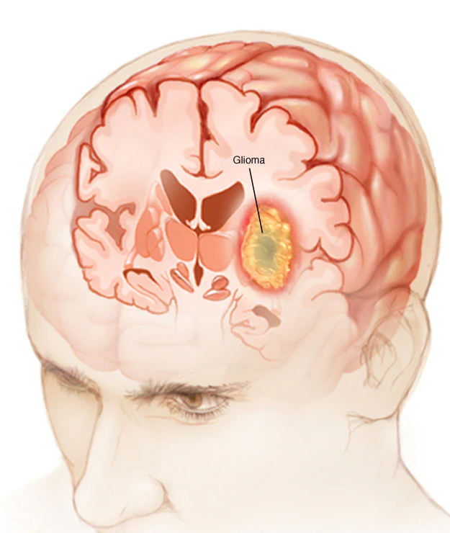
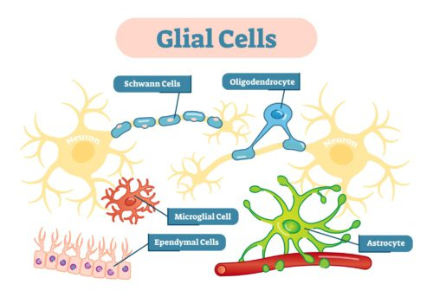
Gliomas

Slide 4
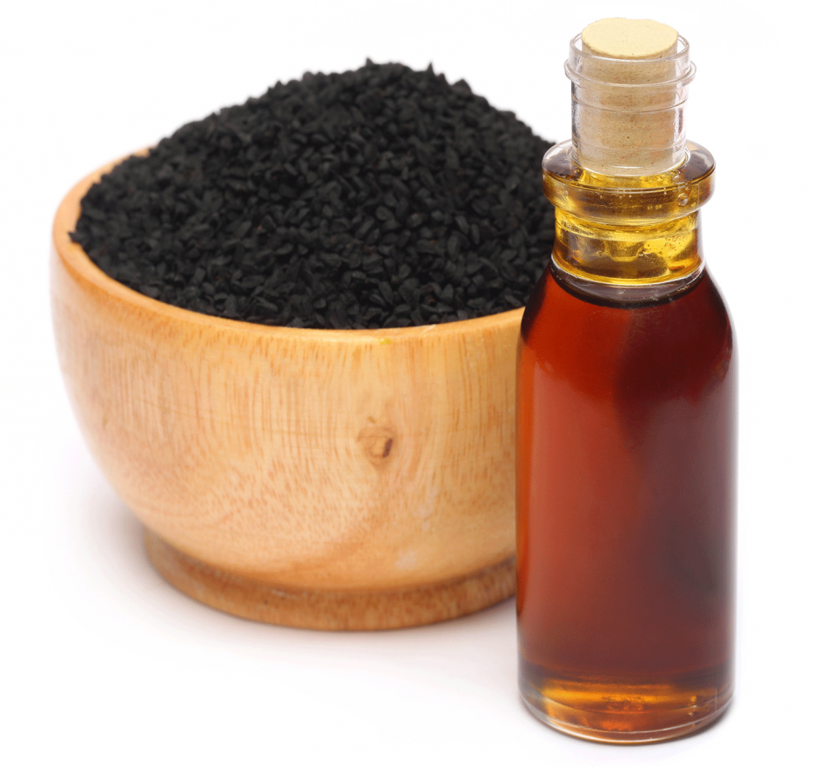
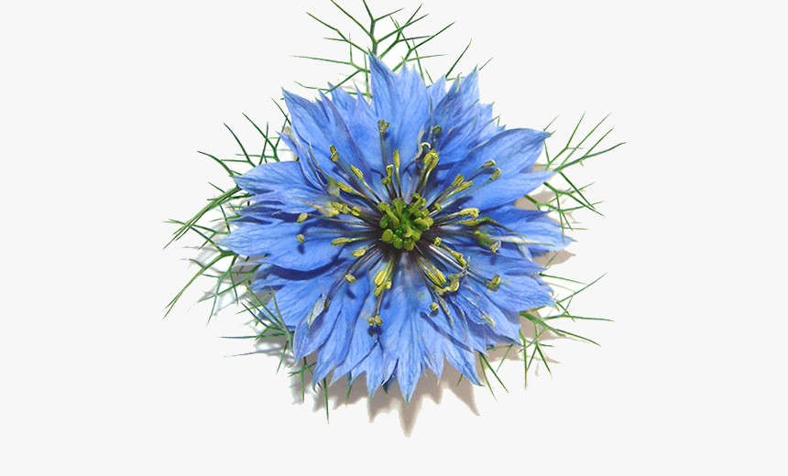
Thymoquinone

Slide 5
Introduction
The anti-tumor properties of thymoquinone^{1,2}
However, there are not enough studies in the literature for its role in brain cancers.
Failure to pass through the blood-brain barrier due to its chemical structure and binding to blood proteins.

Slide 6
Research Question
Does TQ-ox have cytotoxic, genotoxic, and apoptotic effects on glioma cells?

Slide 7
Research Hypothesis
The newly synthesized oxime derivative of Thymoquinone will increase the levels of intracellular reactive oxygen species in glioma cells, leading to high cytotoxicity, genotoxicity and apoptosis.

Slide 8
Materials and Methods

Slide 9
Thymoquinone
Oxime Ring
Thymoquinone-Oxime
Structure determination with NMR³

Slide 10
Cytotoxicity⁵
(w/ATP method)
Inflamation Levels
(IL1β, IL6, TNFα)
(w/Photometric method)
Intracellular ROS⁵
(w/Fluorometric method)
Apoptosis⁵
(w/Fluorescent microscope)
Investigation of anti-tumor effect on GL261
mouse glioma cells
(After 24 hours of incubation)⁴
Intracellular Calcium⁶
(w/Fluorometric method)
DNA Damage⁹
(w/Comet Assay)
MMP levels⁷
(IL1β, IL6, TNFα)
(w/Photometric method)
GSH levels⁸
(w/ATP method)
Statistical analysis was performed using SPSS v25

Slide 11
RESULTS

Slide 12
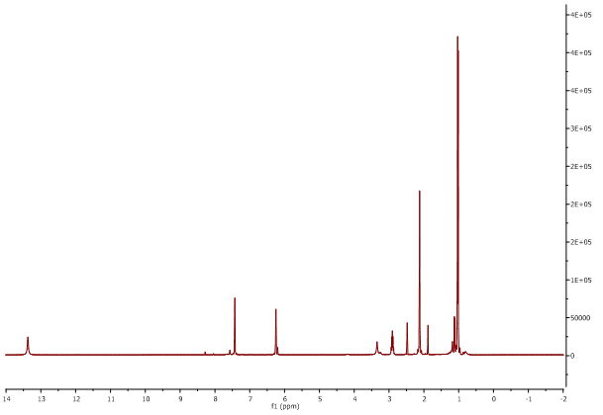
NMR Analysis

Slide 13
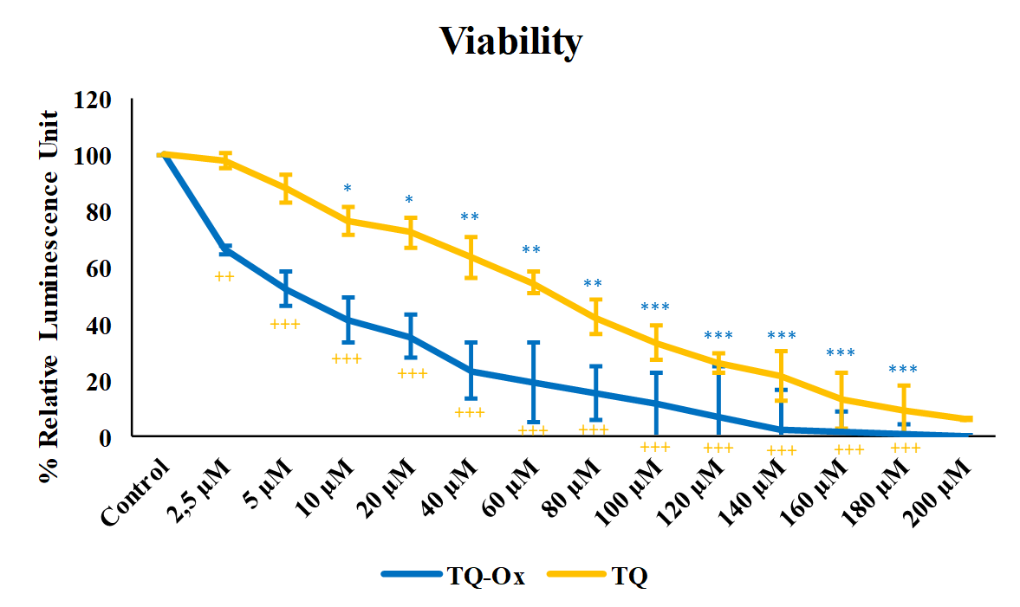
* = p<0,05; **=p<0,01; *** p<0,001
+ = p<0,05; ++=p<0,01; +++ p<0,001

Slide 14
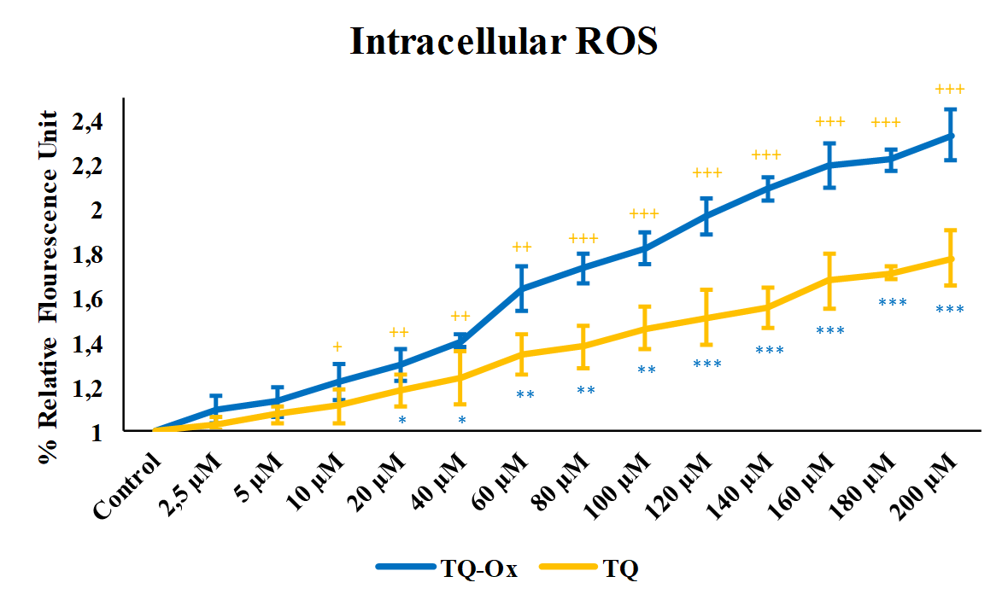
* = p<0,05; **=p<0,01; *** p<0,001
+ = p<0,05; ++=p<0,01; +++ p<0,001

Slide 15
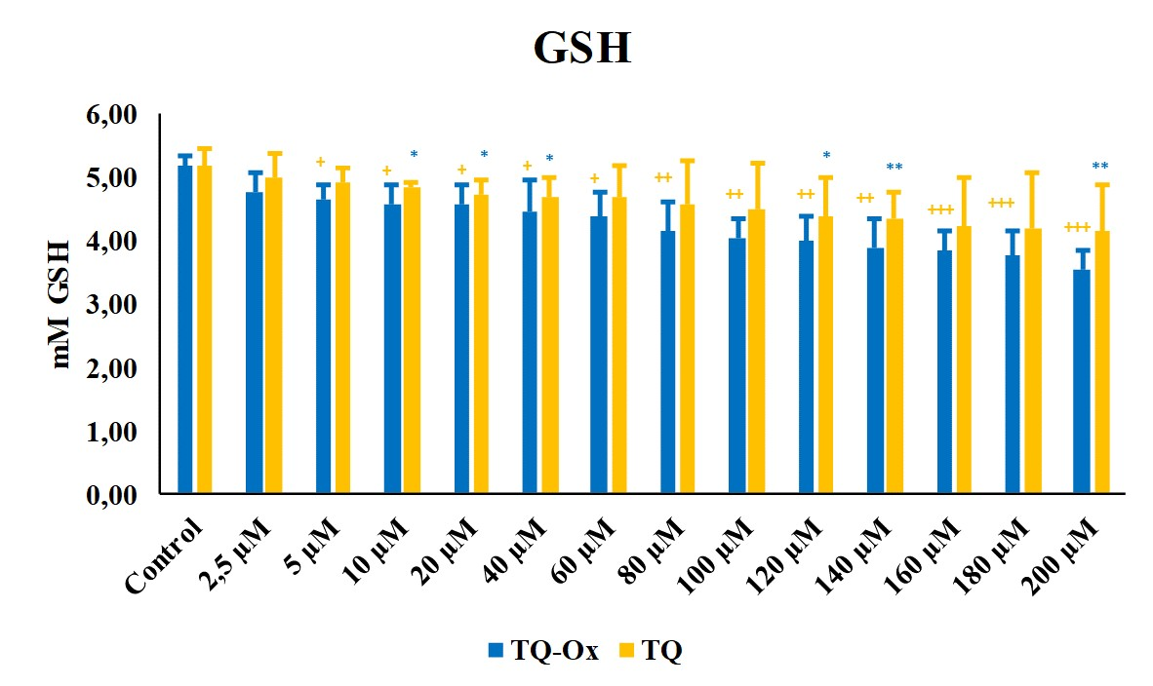
* = p<0,05; **=p<0,01; *** p<0,001
+ = p<0,05; ++=p<0,01; +++ p<0,001

Slide 16
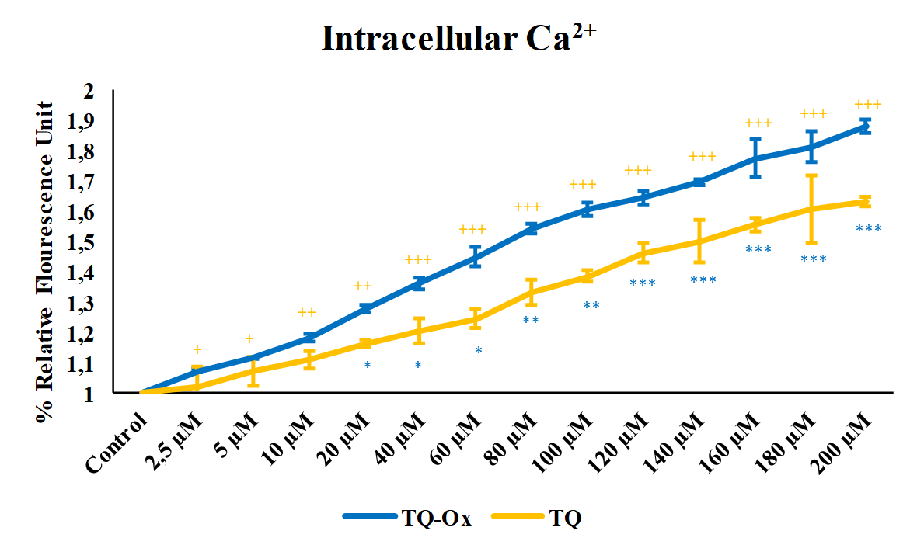
+
* = p<0,05; **=p<0,01; *** p<0,001
+ = p<0,05; ++=p<0,01; +++ p<0,001

Slide 17
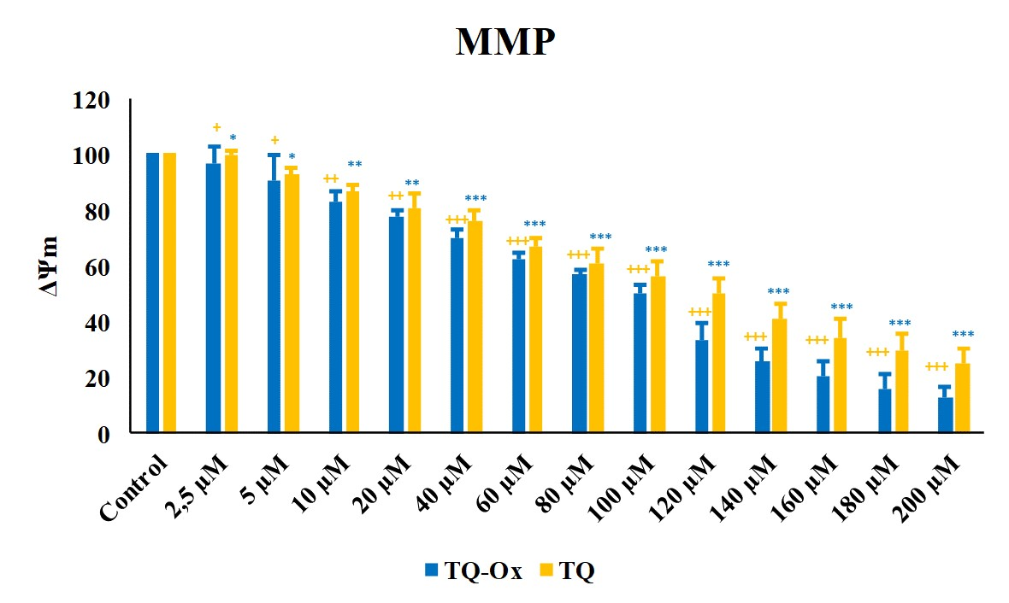
* = p<0,05; **=p<0,01; *** p<0,001
+ = p<0,05; ++=p<0,01; +++ p<0,001

Slide 18
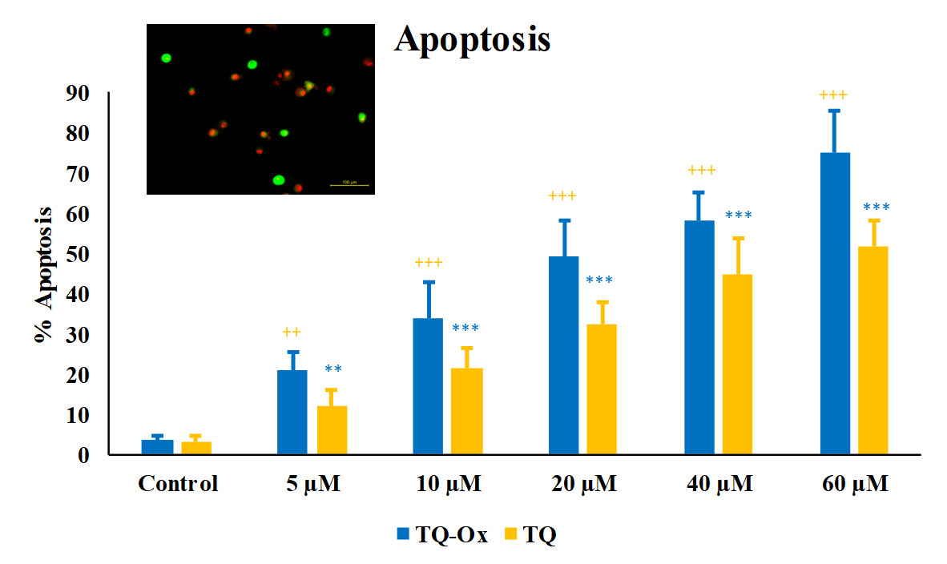
* = p<0,05; **=p<0,01; *** p<0,001
+ = p<0,05; ++=p<0,01; +++ p<0,001

Slide 19
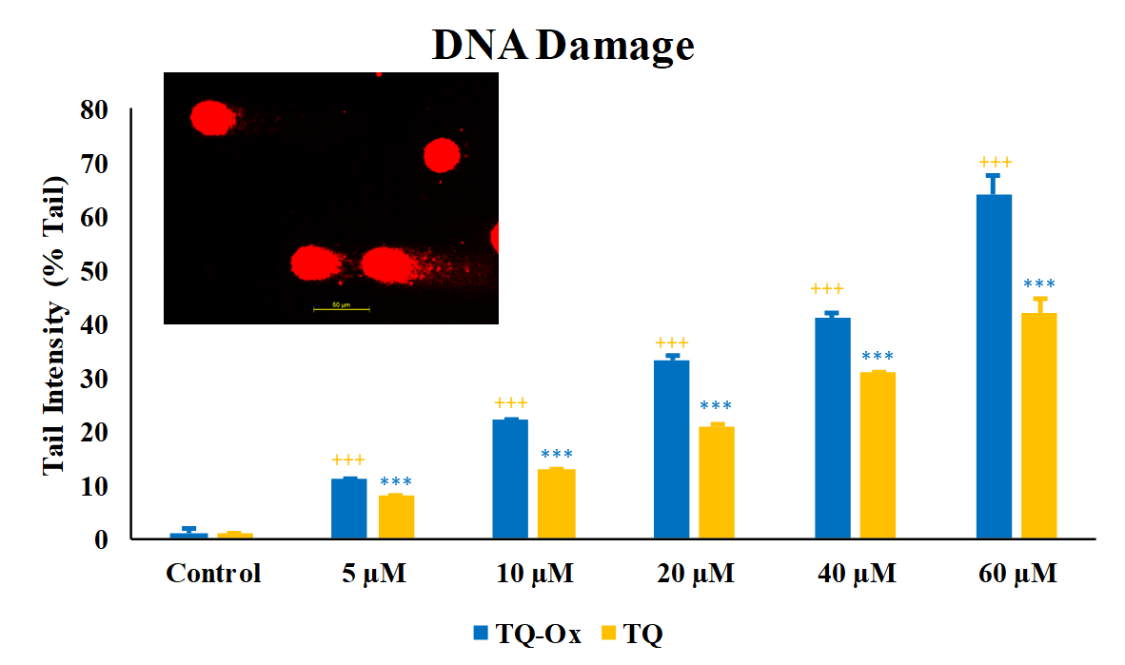
* = p<0,05; **=p<0,01; *** p<0,001
+ = p<0,05; ++=p<0,01; +++ p<0,001

Slide 20
Results
When TQ and TQ-ox were evaluated together, the cytotoxic, genotoxic, and apoptotic effects of TQ-ox were found to be statistically significantly (p<0,001) higher than TQ. While cytotoxicity, DNA damage, apoptosis, intracellular Ca2+, and ROS levels increased significantly (p<0,001) in both TQ-ox and TQ, glutathione and MMP levels decreased significantly (p<0,001) with increasing dose.

Slide 21
Conclusion
According to the results, we propose that TQ-ox has cytotoxic, genotoxic, and apoptotic effects on glioma in a dose-dependent manner, and therefore TQ-ox can be one of the options that can be used for glial cancer treatment.

Slide 22
Discussion
To the best of our knowledge this study is first to report anti-tumor effects of the oxime derivate of thymoquinone on glioma cells in vitro.
To understand thymoquinone-oximes further effects and to show its advantage over thymoquinone and other chemotherapeutics in vivo studies should be conducted.

Slide 23
Next Step
Animal studies ethics commitee approval
Applying for TUBITAK 1002 scholarship
Implanting glial cancer cells to mice as xenograft
Conducting IV therapy with TQ-ox

Slide 24
REFERENCES
Pazhouhi, M., Sariri, R., Khazaei, M. R., Moradi, M. T., & Khazaei, M. (2018). Synergistic effect of temozolomide and thymoquinone on human glioblastoma multiforme cell line (U87MG). Journal of cancer research and therapeutics, 14(5), 1023–1028.
Shoieb, A. M., Elgayyar, M., Dudrick, P. S., Bell, J. L., & Tithof, P. K. (2003). In vitro inhibition of growth and induction of apoptosis in cancer cell lines by thymoquinone. International journal of oncology, 22(1), 107–113.
Kocyigit, A., Koyuncu, I., Taskin, A., Dikilitas, M., Bahadori, F., & Turkkan, B. (2016). Antigenotoxic and antioxidant potentials of newly derivatized compound naringenin-oxime relative to naringenin on human mononuclear cells. Drug and chemical toxicology, 39(1), 66–73.
Newcomb, E. W., Demaria, S., Lukyanov, Y., Shao, Y., Schnee, T., Kawashima, N., . . . McBride, W. H. (2006). The combination of ionizing radiation and peripheral vaccination produces long-term survival of mice bearing established invasive GL261 gliomas. Clinical cancer research, 12(15), 4730-4737.
Kocyigit, A., & Guler, E. M. (2017). Curcumin induce DNA damage and apoptosis through generation of reactive oxygen species and reducing mitochondrial membrane potential in melanoma cancer cells. Cellular and molecular biology (Noisy-le-Grand, France), 63(11), 97-105.
Li, P., Zhao, Q.-L., Jawaid, P., Rehman, M. U., Sakurai, H., & Kondo, T. (2016). Enhancement of hyperthermia-induced apoptosis by 5Z-7-oxozeaenol, a TAK1 inhibitor, in A549 cells. Cell Stress and Chaperones, 21(5), 873-881.
Kocyigit A, Guler EM, Karatas E, Caglar H, Bulut H. Dose-dependent proliferative and cytotoxic effects of melatonin on human epidermoid carcinoma and normal skin fibroblast cells. Mutat Res. 2018;829- 830:50-60
Günes-Bayir A, Kiziltan HS, Kocyigit A, Güler EM, Karataş E, Toprak A. Effects of natural phenolic compound carvacrol on the human gastric adenocarcinoma (AGS) cells in vitro. Anti-cancer drugs. 2017;28(5):522-30
Singh, N. P. (2016). The comet assay: reflections on its development, evolution and applications. Mutation research/Reviews in mutation research, 767, 23-30.

Slide 25
THANK YOU FOR LISTENING

